Slide 1
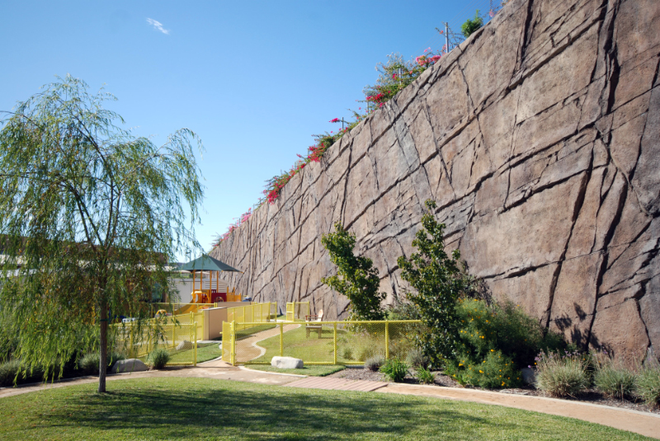
History of and Recent Advances in Designing Soil Nail Walls
September 20, 2023
HOAG HOSPITAL – NEW PORT BEACH, CA.

Slide 2
Agenda
Soil Nailing – History +Insight
History – Prof. Shen/Larry Kulchin
Prof. Vucetic – Bi-Linear Failure Plane
2. Recent Advances
Post Tensioned Soil Nailing
V-Nails
Hybrid Soil Nailing
Optimization

Slide 3
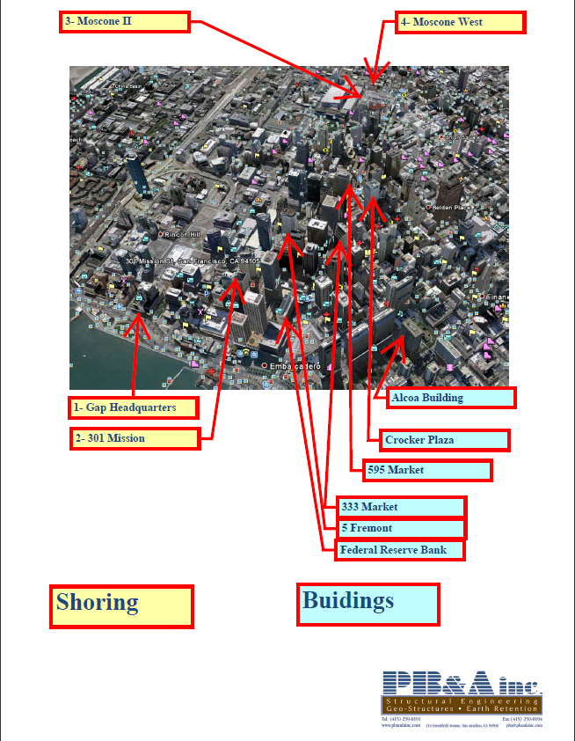
Past Experience Designs of Structures
Skidmore, Owings and Merrill - SOM
March 1968
Buildings

Slide 4
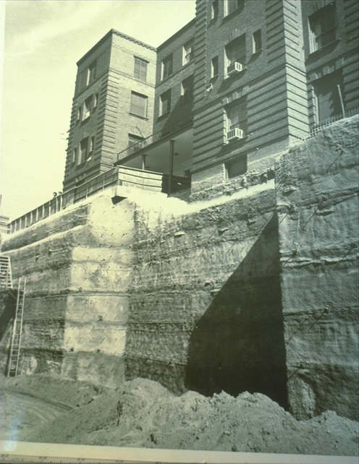
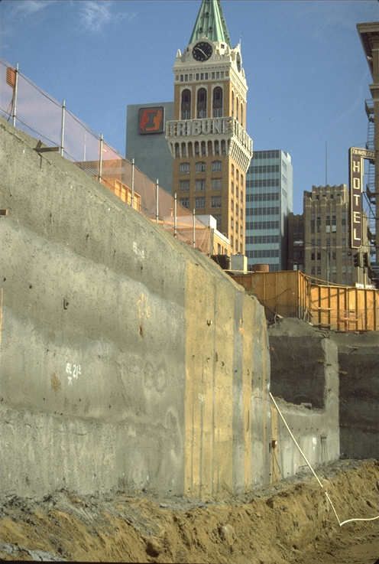
Soil Nailing History
1st. Soil Nail Wall Built in the US (1978)
Early Soil Nail Wall by PB&A – EBMUD in Oakland, CA (1985)

Slide 6
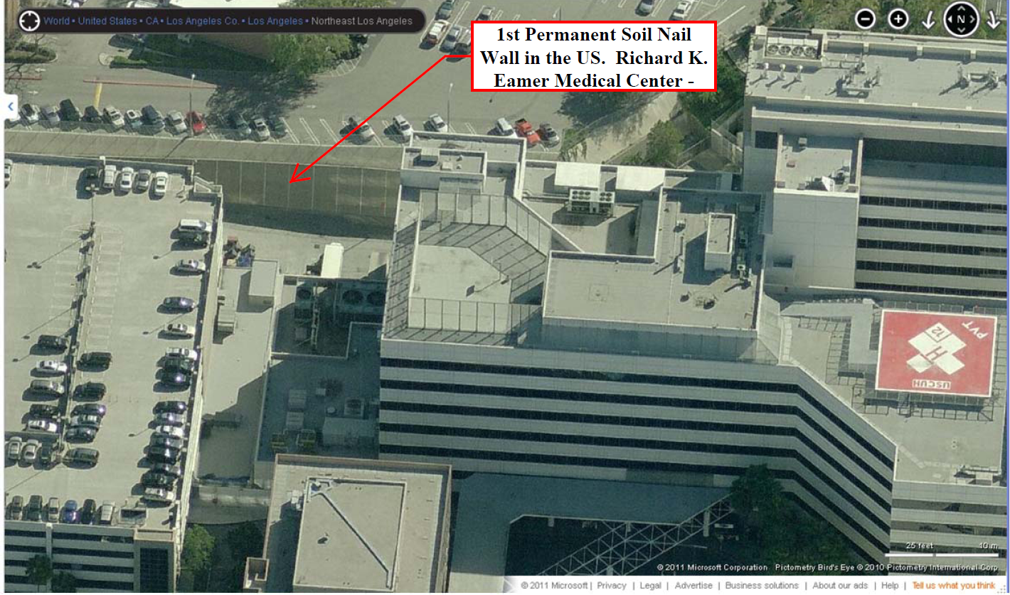
Richard K. Eamer Medical Center, USC Campus
1st Permanent Soil Nail Wall in the United States
Circa - 1986

Slide 7
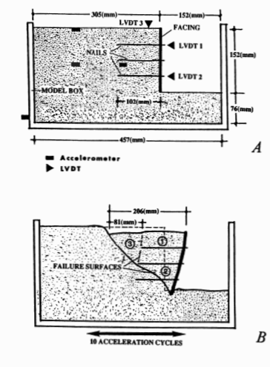

Slide 8
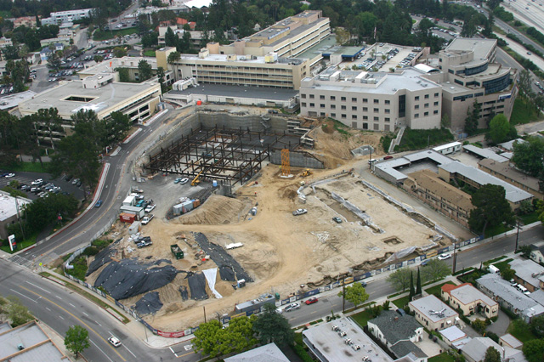
Glendale Adventist Medical Center –Acute Care Facility

Slide 9
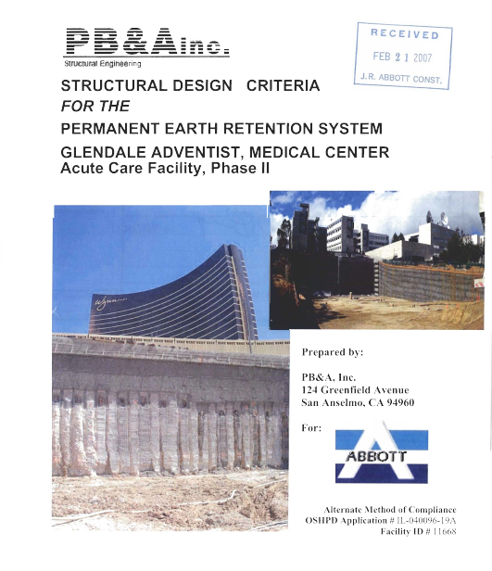
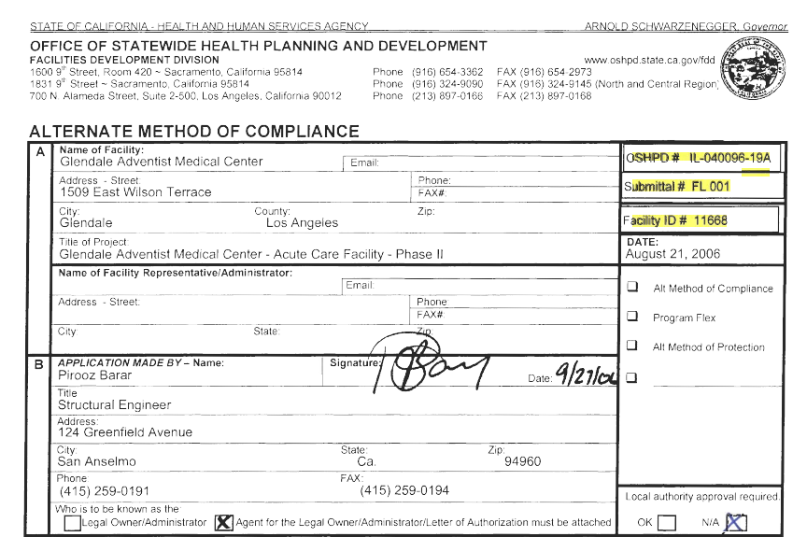
OSHPD = HCAI
Alternate Method of Compliance
Aug. 21, 2006
www.pbandainc.com/wp-content/uploads/2013/07/oshpd.pdf
DATE 04/25/00

Slide 10
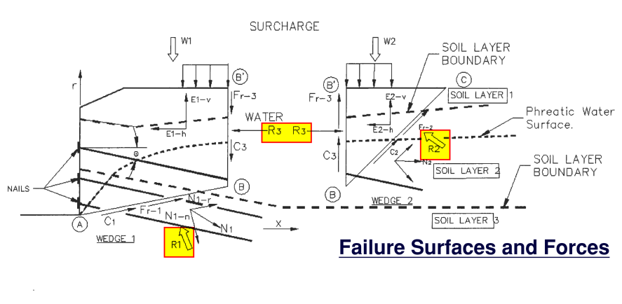

Slide 11
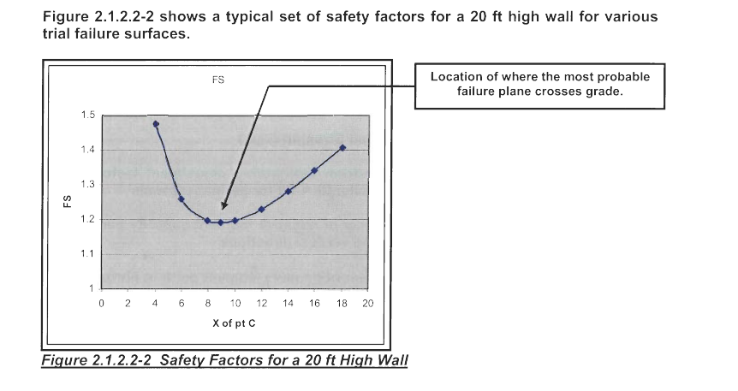
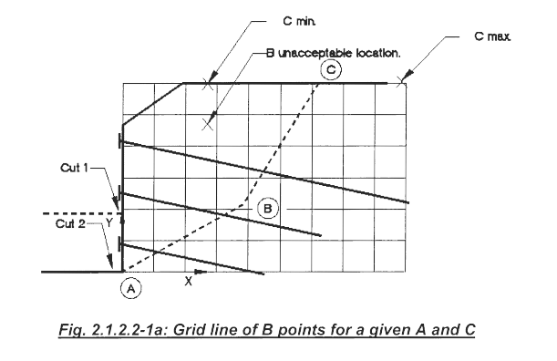
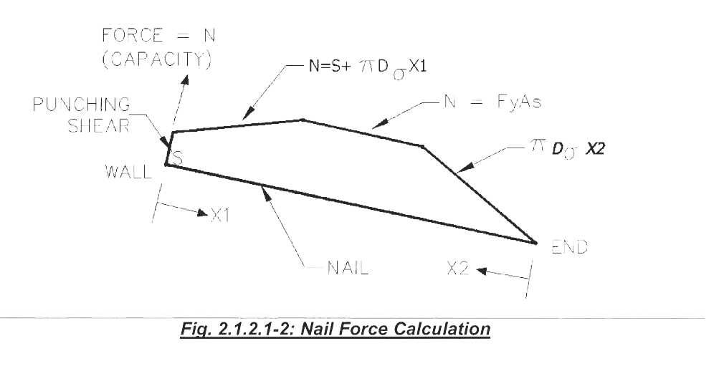

Slide 12
Agenda
Soil Nailing – History +Insite
History – Prof. Shen/Larry Kulchin
Prof. Vucetic – Bi-Linear Failure Plane
2. Recent Advances
Post Tensioned Soil Nailing
V-Nails
Hybrid Soil Nailing
Optimization

Slide 13
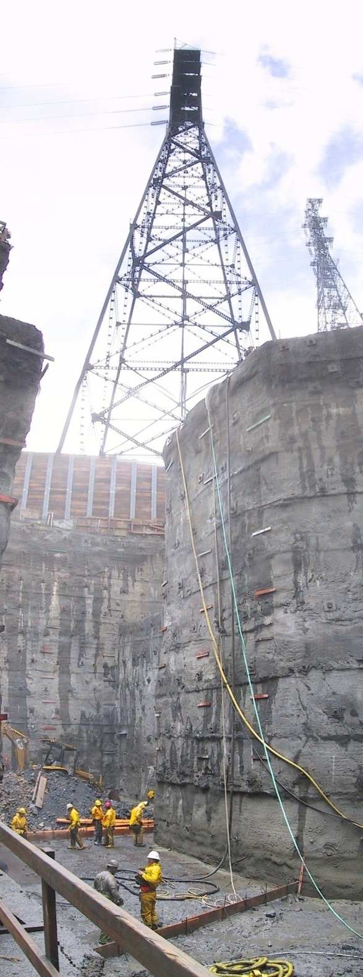
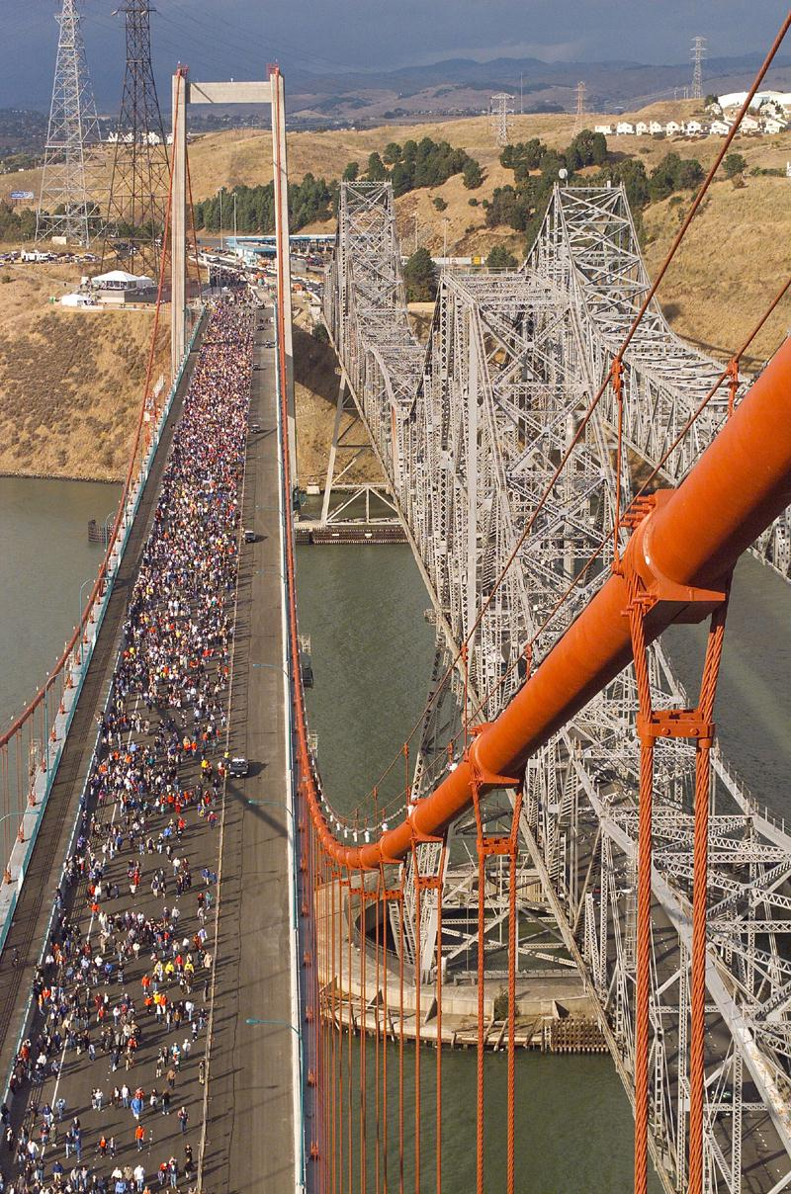
Caquinez
Bridge
Shoring
Before and after
North Anchorage
=======
Post-Tensioned
Soil nailing

Slide 14
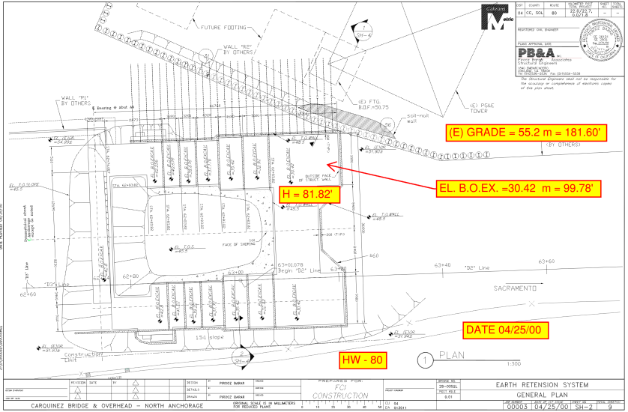
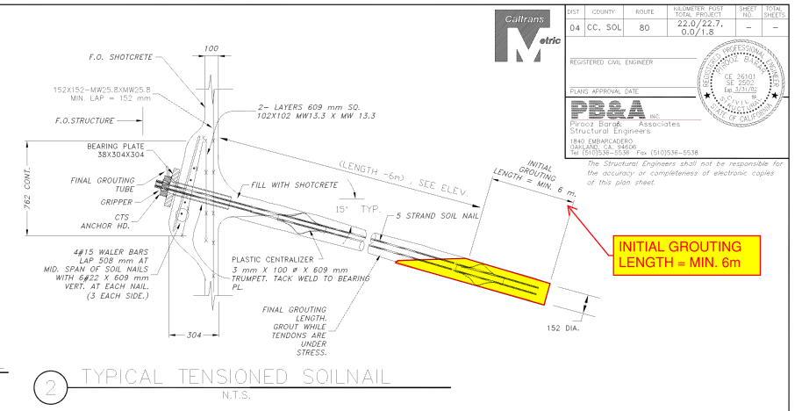
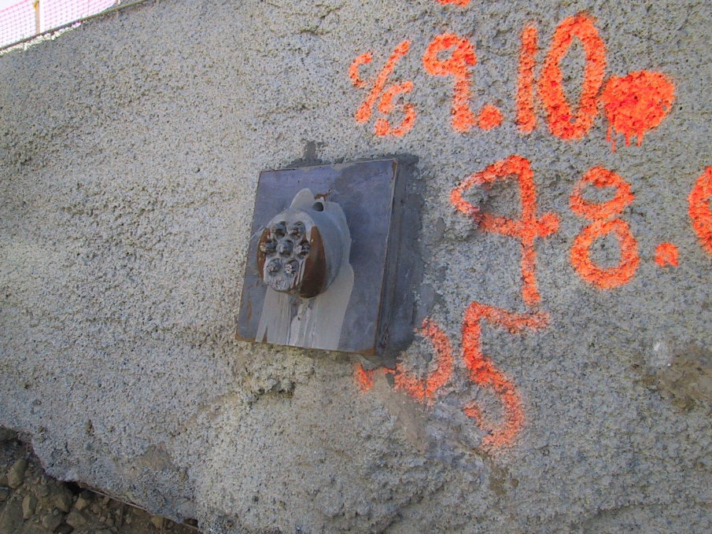

Slide 15
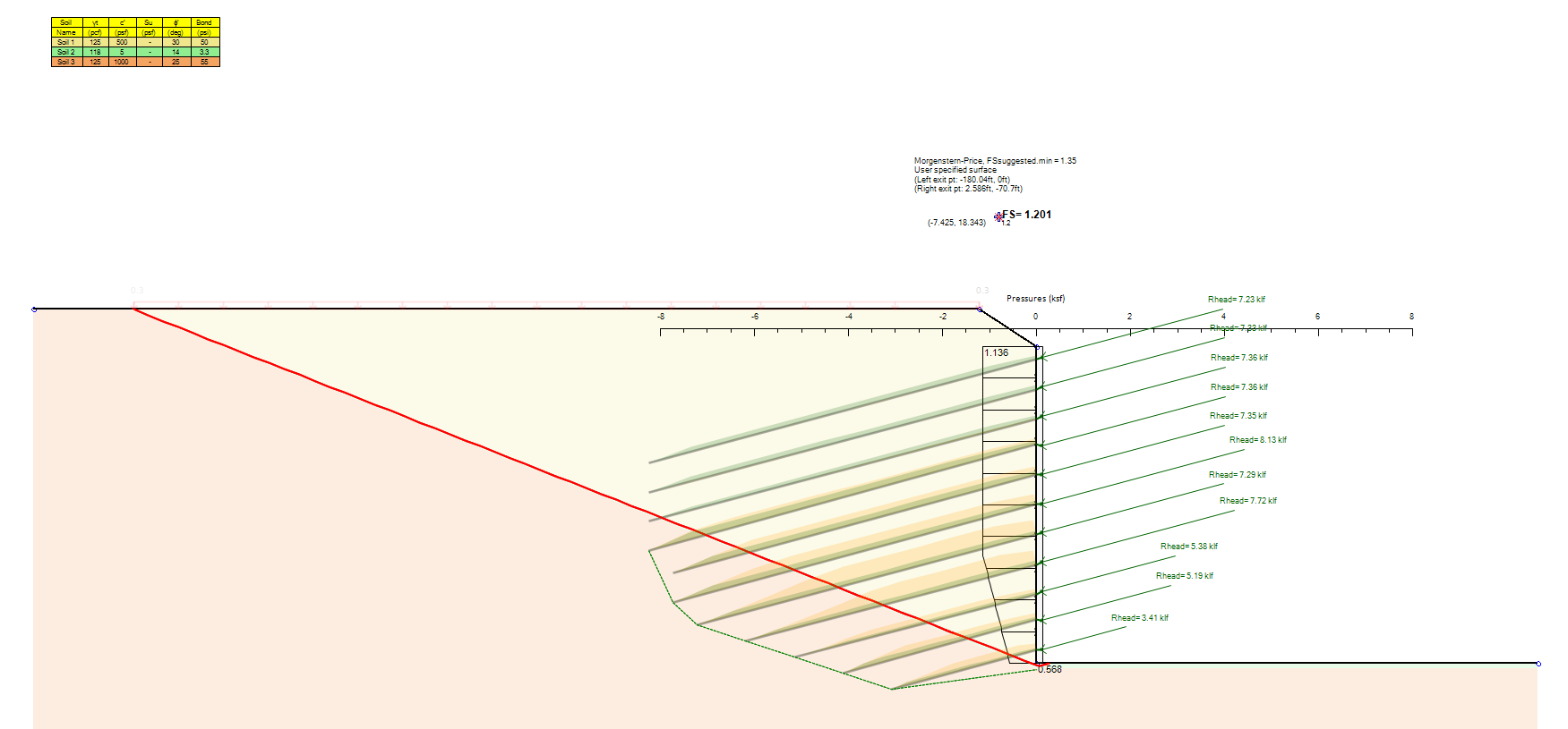
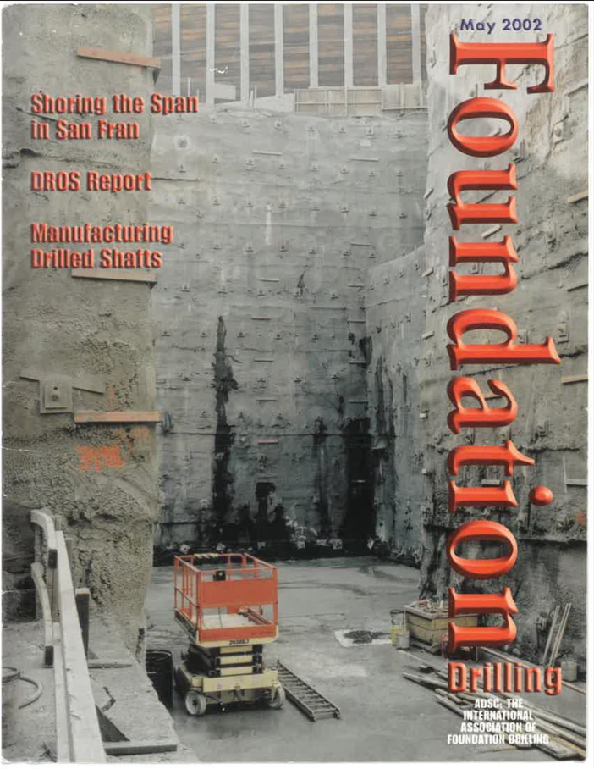
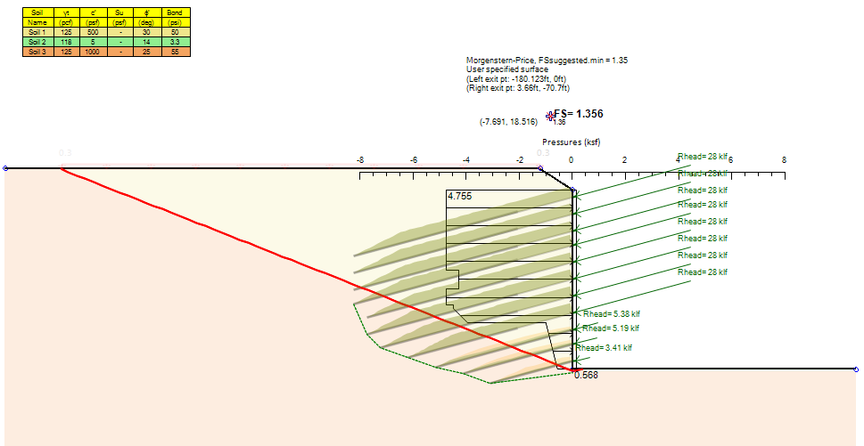
F.O.S =1.2
F.O.S =1.356

Slide 16
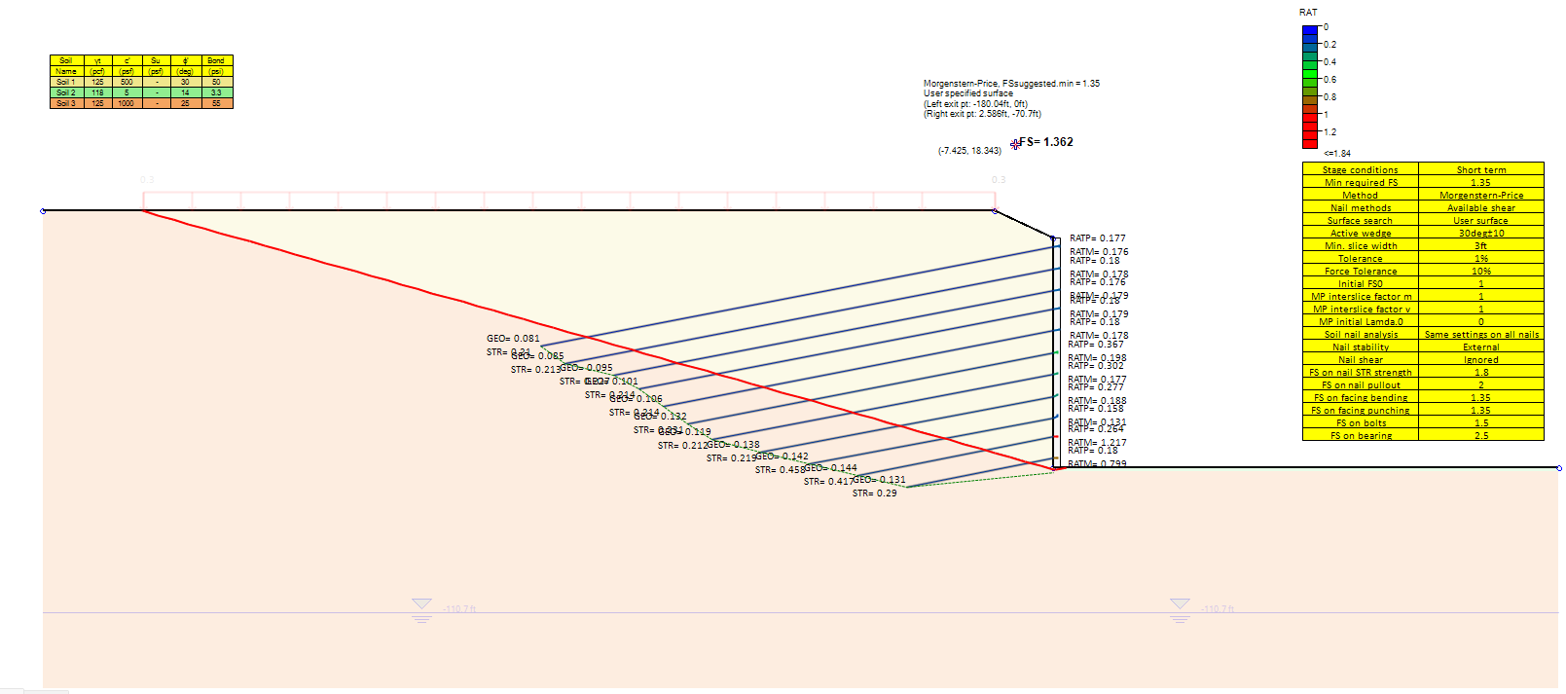
 | Nail Length in Original Design (ft) | Nail Length needed to achieve FoS of 1.351 (ft) | Difference in Length (ft)
Nail 1 | 80 | 115 | 35
Nail 2 | 80 | 105 | 25
Nail 3 | 80 | 100 | 20
Nail 4 | 80 | 95 | 15
Nail 5 | 75 | 90 | 15
Nail 6 | 75 | 80 | 5
Nail 7 | 70 | 70 | 0
Nail 8 | 60 | 60 | 0
Nail 9 | 50 | 50 | 0
Nail 10 | 40 | 40 | 0
Nail 11 | 30 | 30 | 0
 |  | Total | 115

Slide 17
Wx
Rx
Wy
1. General slope stability:
- General limit equilibrium approach
- Include all forces in slice
- Determine force equilibrium in every slice
- Large nail forces might turn sliding mode into passive (showing smaller FS)
W
Nail R
Ry
2. Mobilized shear approach (passive nails):
- Passive nails are reactionary
- Without nails, determine safety factors, available soil shear resistance, and required shear resistance for a safety factor of one
- Determine available nail shear resistance at each slice without satisfying force equilibrium
3. Mobilized shear approach (prestressed nails):
- Run slope stability analysis considering applicable prestress force
- Determine force equilibrium in every slice with the prestress force (.p in equation below)
- Determine remaining available nail shear resistance (Design Ultimate – prestress) at each slice without satisfying force equilibrium
$${FS}_{mob}=\frac{{Στ}_{res.available.soil }+ {Στ}_{res.nails}}{Στ_{required.FS=1.0}}$$
$${FS}_{mob.p}=\frac{{Στ}_{res.available.soil.p }+ {Στ}_{res.nails.non.prestress}}{{Στ}_{required.p.FS=1.0}}$$

Slide 18
Agenda
Soil Nailing – History +Insite
History – Prof. Shen/Larry Kulchin
Prof. Vucetic – Bi-Linear Failure Plane
2. Recent Advances
Post Tensioned Soil Nailing
V-Nails
Hybrid Soil Nailing
Optimization

Slide 19
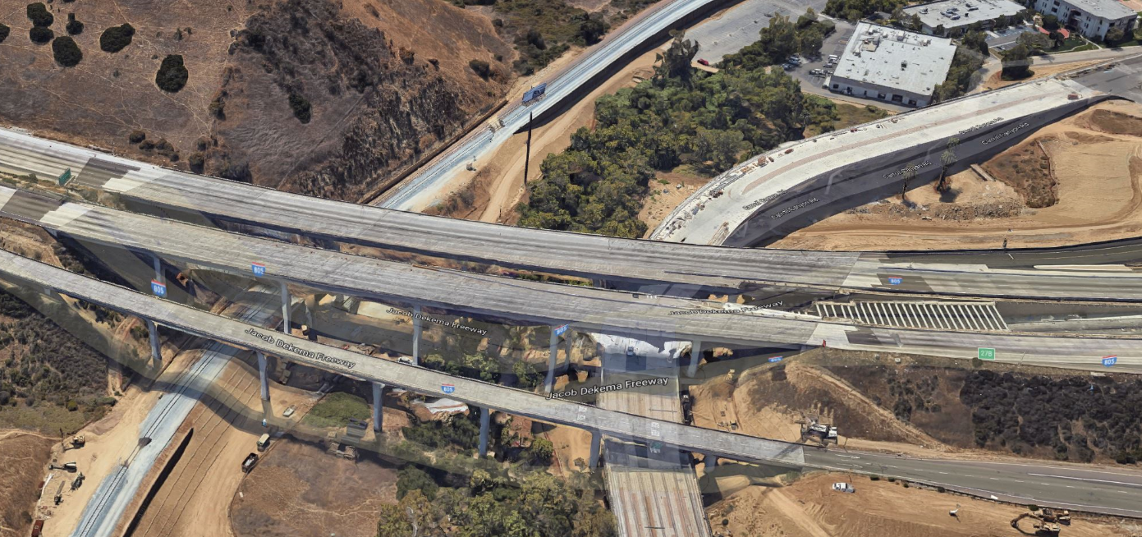
Carroll Canyon DAR – I-805 – San Diego
Use of V-Nails For Retention of Live Highway
Internal Bracing – Designed by T.Y. Lin
805-S
805-N
HOV

Slide 20
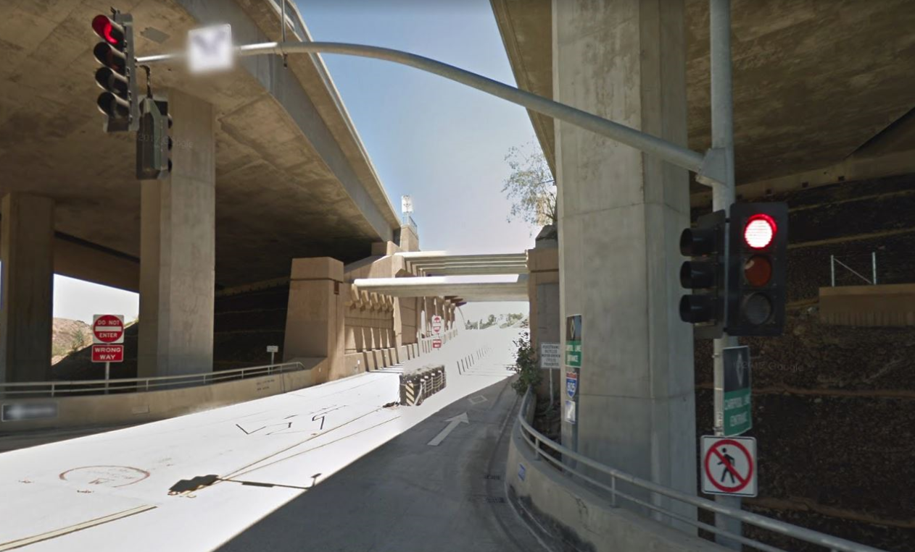

Slide 22
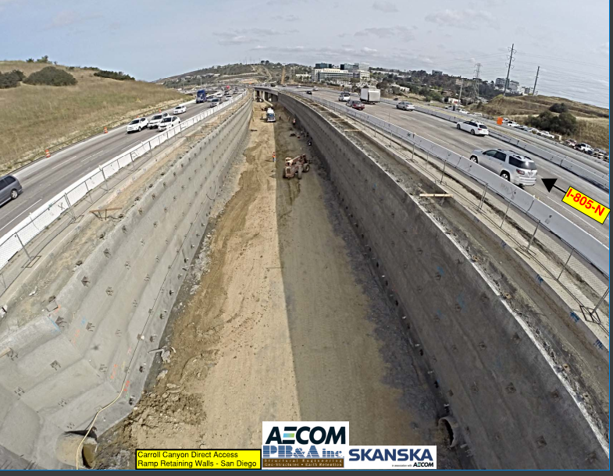
V-NAILS

Slide 23
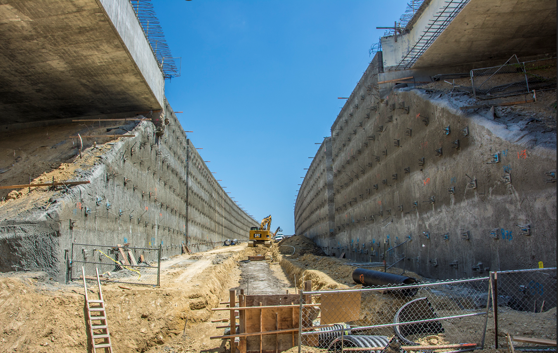
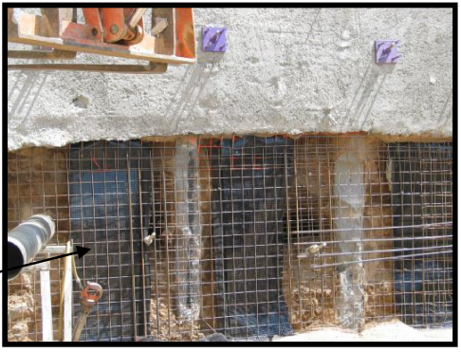
I-805 N
I-805 N
V-NAILS

Slide 24
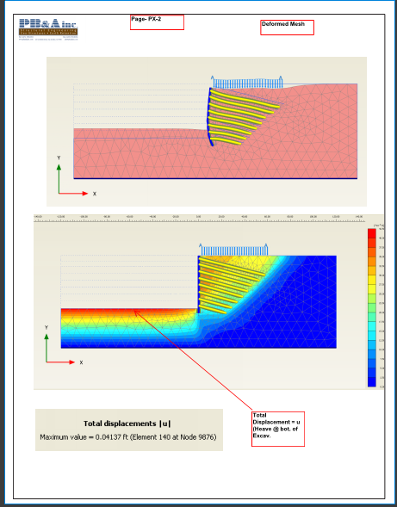
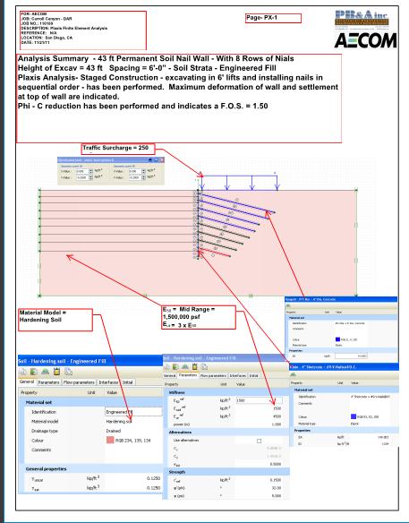

Slide 25
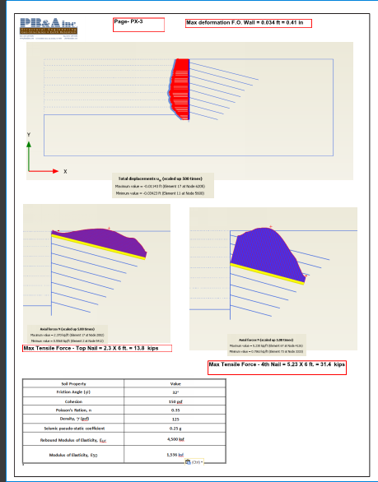
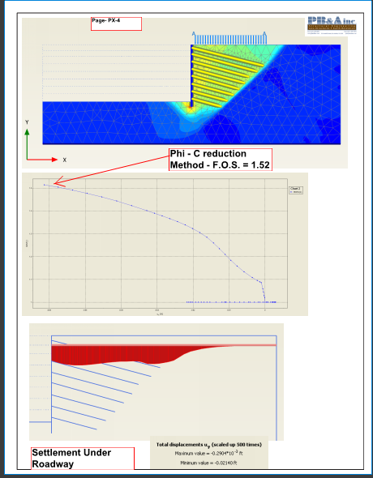

Slide 26
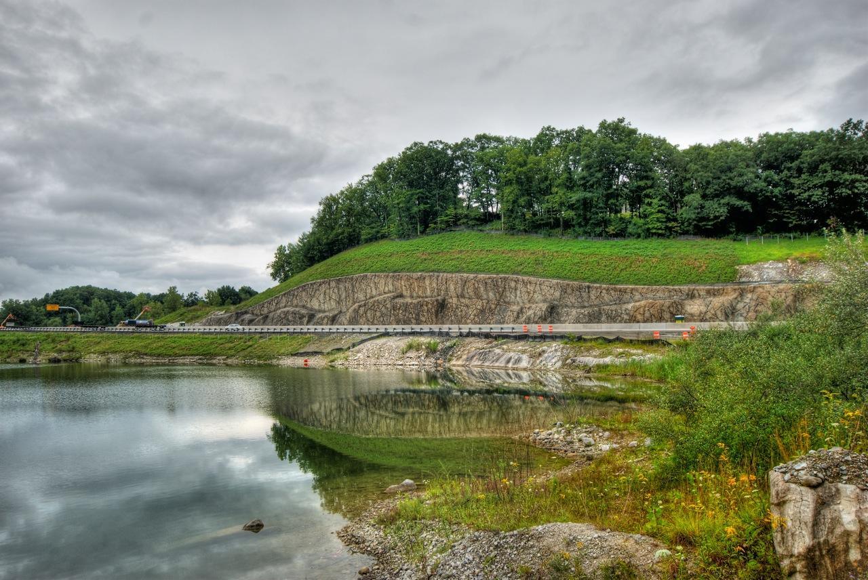
Brookfield, CT. US-7

Slide 27
Agenda
Soil Nailing – History +Insite
History – Prof. Shen/Larry Kulchin
Prof. Vucetic – Bi-Linear Failure Plane
2. Recent Advances
Post Tensioned Soil Nailing
V-Nails
Hybrid Soil Nailing
Optimization

Slide 28
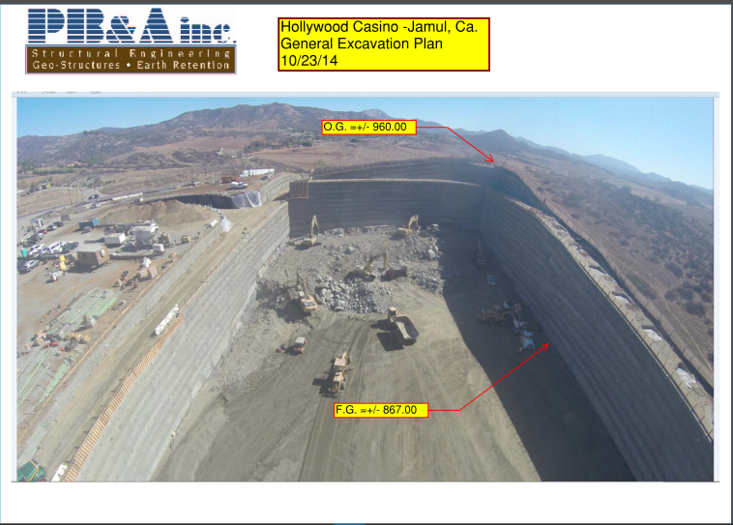

Slide 29
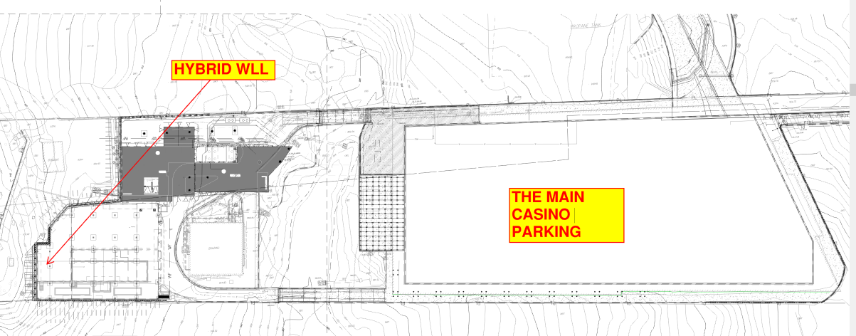
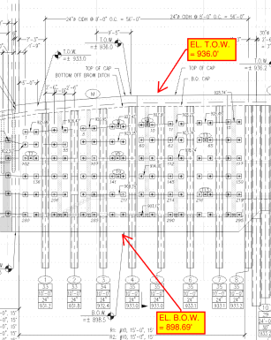
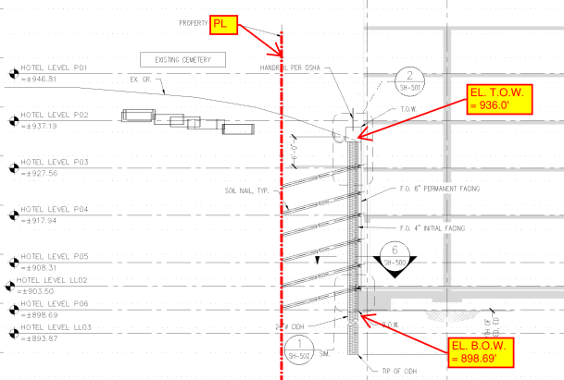

Slide 30
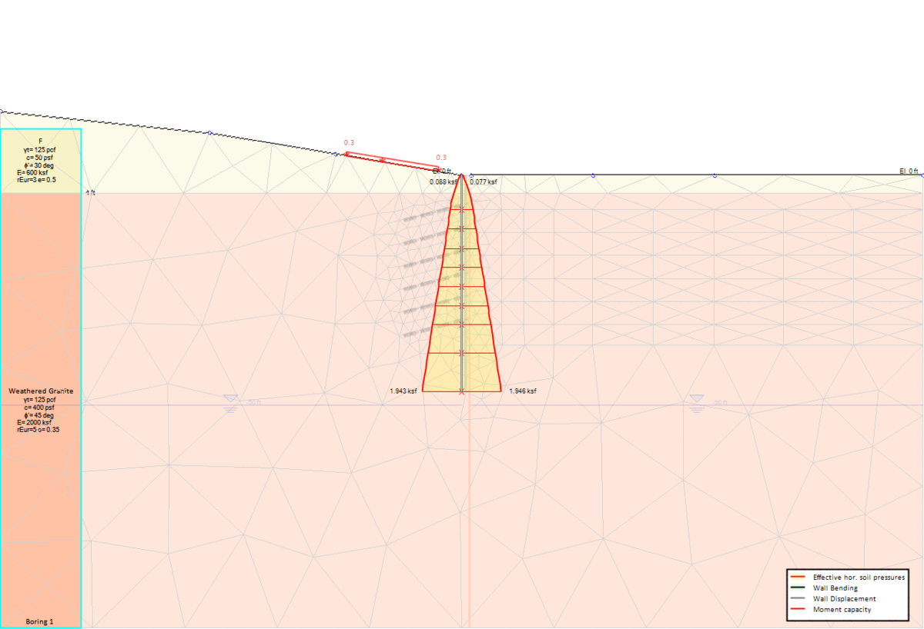
Hybrid Wall
Finite Element Analysis of Hybrid Wall with staged construction for “Jamul Casino Extension”

Slide 31
Agenda
Soil Nailing – History +Insite
History – Prof. Shen/Larry Kulchin
Prof. Vucetic – Bi-Linear Failure Plane
2. Recent Advances
Post Tensioned Soil Nailing
V-Nails
Hybrid Soil Nailing
Optimization

Slide 32
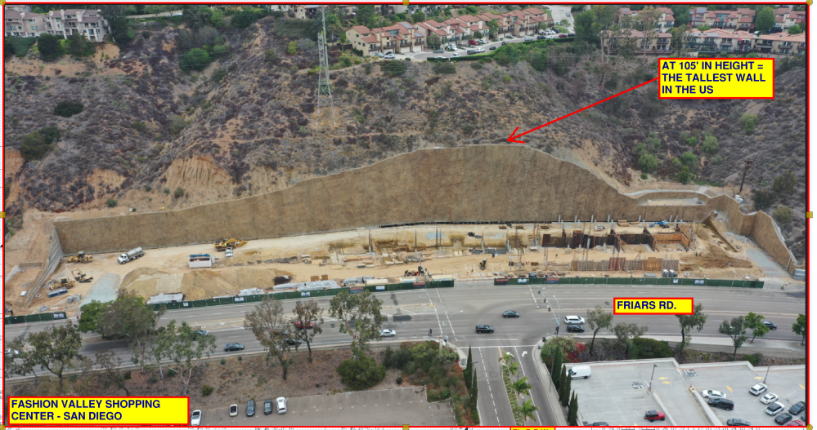
The Height

Slide 33
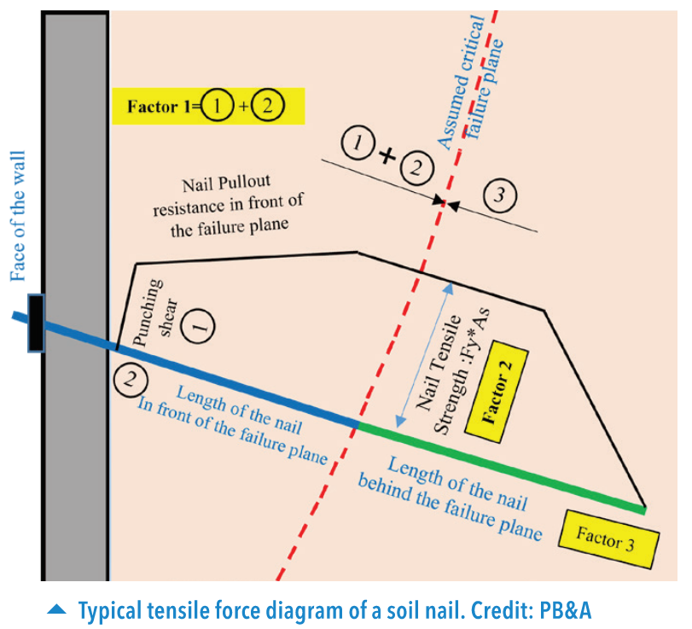
Soil Nail Optimization
For each soil nail, three factors are considered in the evaluation of the overall FOS of the wall:
Factor 1 – Punching shear plus pullout strength of the length of the nail in front of the failure plane.
Factor 2 – Yield strength of the soil nail,
Factor 3 – Pull out the strength of the soil nail length behind the failure plane
THE CONTRIBUTION OF EACH NAIL IS THE MINIMUM OF THE ABOVE 3 FACTORS.

Slide 34
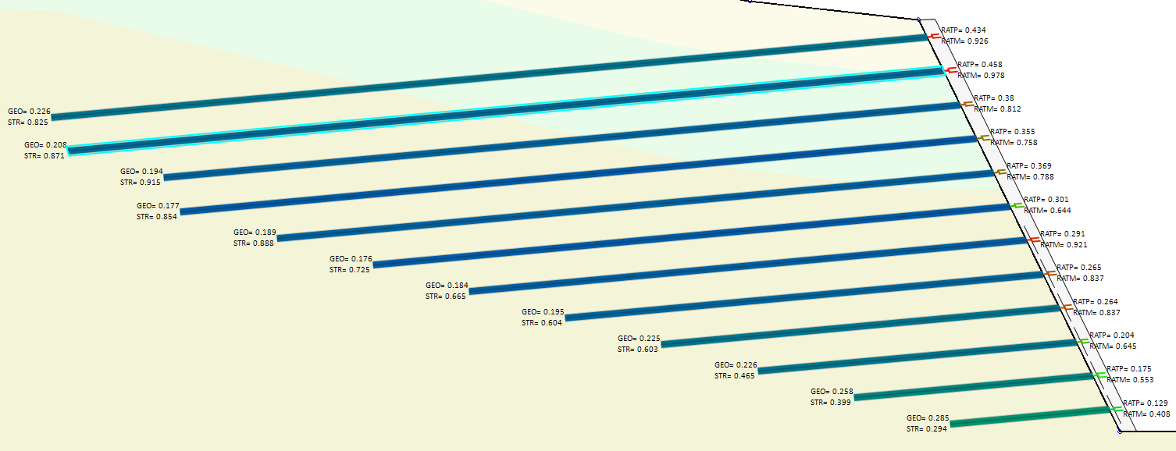
Soil Nail Optimization

Slide 35
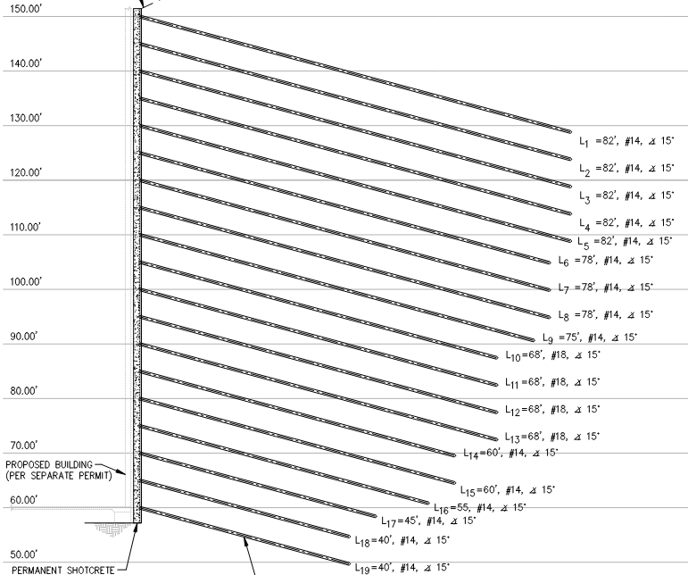
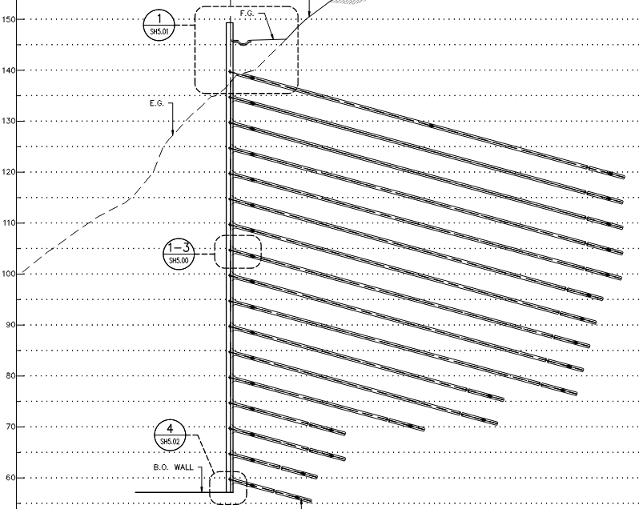
Soil Nail Optimization
Original Design
PB&A Design

Slide 36
Soil Nail Optimization
Row # | L (ft) | Size
1 | 82 | #14
2 | 82 | #14
3 | 82 | #14
4 | 82 | #14
5 | 82 | #14
6 | 78 | #14
7 | 78 | #14
8 | 78 | #14
9 | 75 | #14
10 | 68 | #18
11 | 68 | #18
12 | 68 | #18
13 | 68 | #18
14 | 60 | #14
15 | 60 | #14
16 | 55 | #14
17 | 45 | #14
18 | 40 | #14
19 | 40 | #14
Row # | L (ft) | Size
1 | 75 | #10
2 | 70 | #10
3 | 70 | #10
4 | 70 | #10
5 | 70 | #10
6 | 65 | #10
7 | 65 | #10
8 | 65 | #10
9 | 65 | #18
10 | 60 | #18
11 | 60 | #18
12 | 60 | #18
13 | 60 | #18
14 | 50 | #14
15 | 40 | #14
16 | 30 | #14
17 | 25 | #14
18 | 20 | #14
19 | 15 | #14
Row # | Diff. in Length (ft)
1 | 7
2 | 12
3 | 12
4 | 12
5 | 12
6 | 13
7 | 13
8 | 13
9 | 10
10 | 8
11 | 8
12 | 8
13 | 8
14 | 10
15 | 20
16 | 25
17 | 20
18 | 20
19 | 25
Total | 256
Length Optimization per 1 column of nails
Original Design
PB&A Design

Slide 37
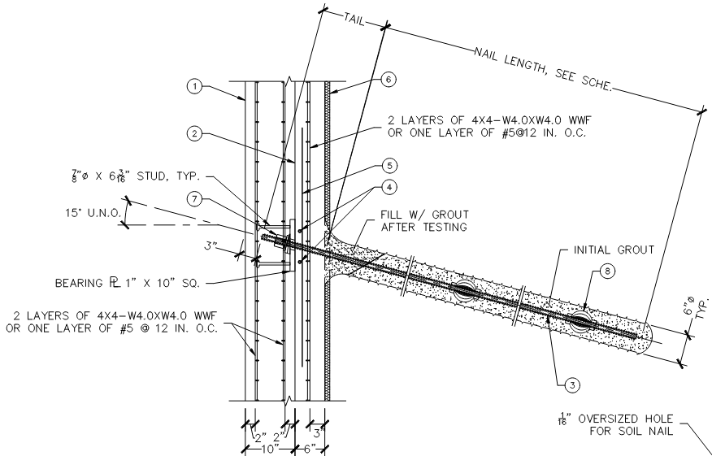
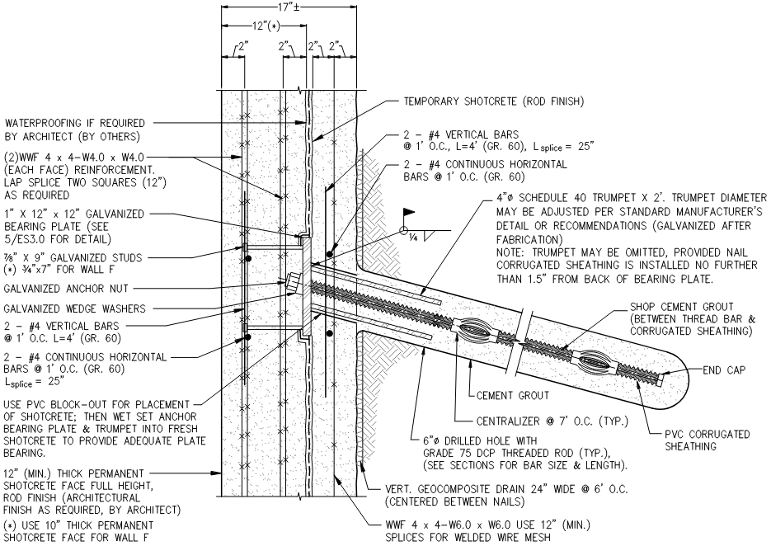
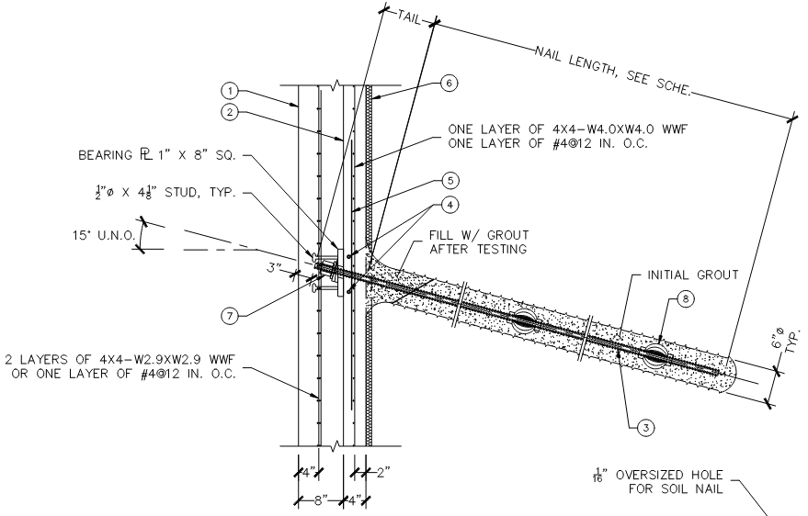
Soil Nail Optimization
Original Design
PB&A Design
17’’+/- total facing thickness for entire wall height
10 to 18’’ total facing thickness varies based on wall height

Slide 38
Soil Nail Optimization
“Top to bottom, PB&A was able to reduce the length of the soil nails by 44 percent”
“PB&A’s optimized design reduced the overall weight of the required steel by 65 percent.”
“The soil nail-facing optimization resulted in a 23 percent reduction in concrete over the entire length of the project.”
“PB&A's design optimization saved approximately $2,000,000 (of a total of $7,000,000) in construction costs and improved construction scheduling and productivity.”

Slide 39
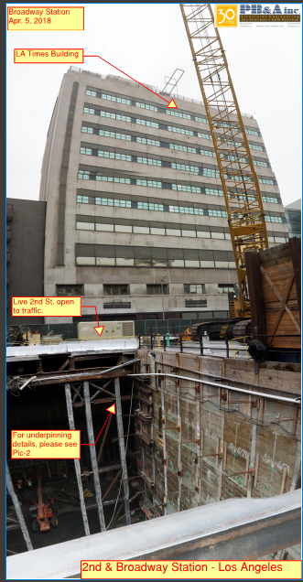
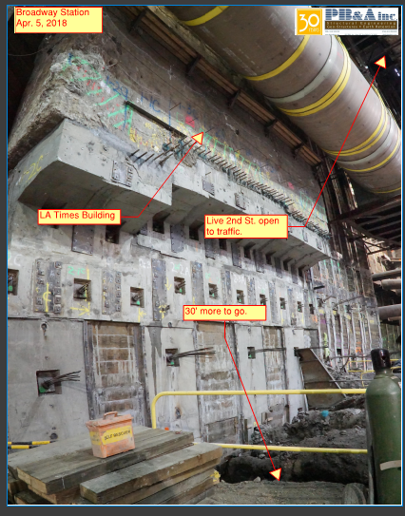

Slide 40
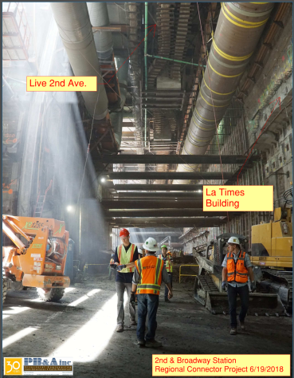

Slide 41
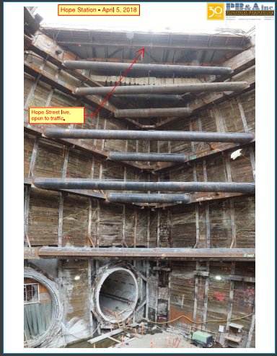

Slide 42
